Slide 1

Python basics

Slide 2
Content
Operations
Variables
Data structures
Operators
Number systems conversion
Bitwise operations
Math library
User Input
Conditional statements
Loops
Examples
Arrays

Slide 3
Content
Functions
Recursion
Anonymous functions
Filter map reduce
Decorators
Modules
Special variable _name_

Slide 4
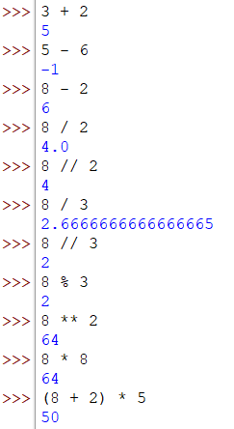
Operations
Python can do all operations (addition, subtraction, multiplication, division, modulus, etc..)

Slide 5
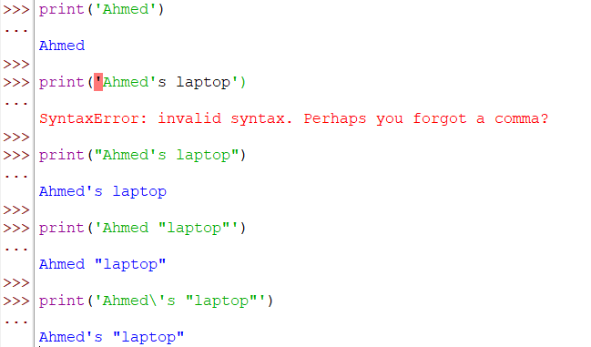
Printing output
We use a built in function `print()`.

Slide 6
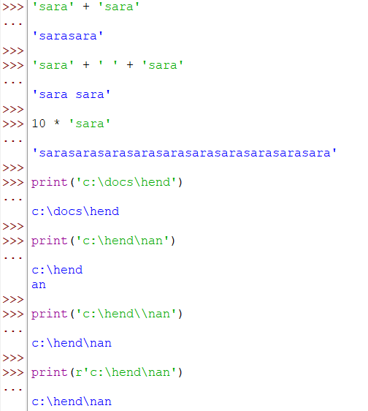
Concatenation

Slide 7
Content
Operations
Variables
Data structures
Operators
Number systems conversion
Bitwise operations
Math library
User Input
Conditional statements
Loops
Examples
Arrays

Slide 8
2. Variables
It is a container where we can put our values in, for example, we can put 2 in a container x, x here is the variable name.
Putting a value in a variable is called “Assignment”, and it doesn’t print any value.
Example: Assigning 2 to x ⇒ `x = 2`
We can do any operations with this variables, we can add 2 to x where the result will be 4, and so on..
We can change the value of the variable any time.

Slide 9
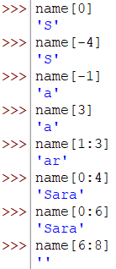
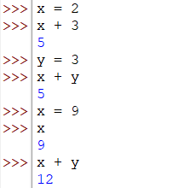
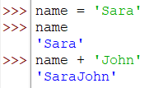
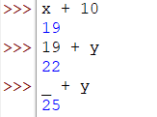
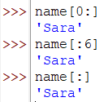
Variables with numbers
Variables with strings
The string is a number of characters, so to get a specific number, we need to specify its index
If we have `John` string, it is represented by an array:
So, to fetch the first element, we can use: `name[0]` or `name[-n]`, where n is the length of the string.
If we want to fetch a substring `oh` for example, we can use `name[1:3]` as the first number is inclusive and the second one is exclusive.
J | o | h | n
0 | 1 | 2 | 3
-4 | -3 | -2 | -1

Slide 10
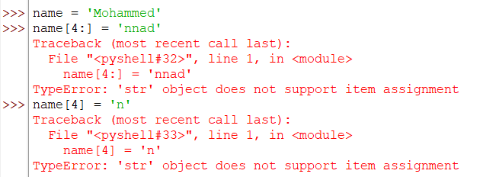


In python, strings are immutable, which means it is not allowable to be changed.
But we can change it by another way which is:
To know the length of the string, we can use the built in function `len()`:

Slide 11
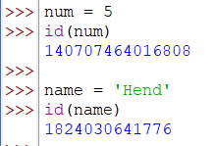
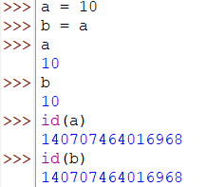
Each variable has a position in the memory, this position is called `address`. To know the address, we can use `id()` built in function:
In python, if two variables have the same value, thus they both will point to the same address. That’s where Python is more memory efficient.

Slide 12
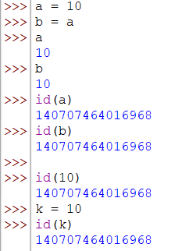
The address is not based on the variable name, it is based on the position itself.
For example, if we create another variable `k` which holds the same value as `a` and `b`, k will refer to the same address.

Slide 13
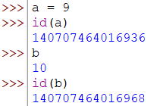
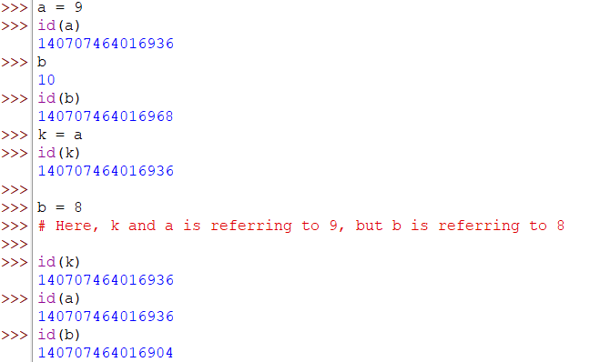
So, the address is affected by the value that is hold inside the variable box. If the value holded is changed, the address will be change.
—-------------------------------------------------------------------------------------------------------

Slide 14
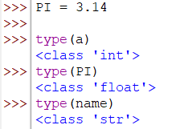
Here, we have changed the values of a, b and k, so the first value which is 10, what happened to it?
10 is dead in the memory, and it became useless. This value will be garbage collected later.
Constants(where the values can’t be changed):
How to create a constant?
We can show out intention that this value is constant by naming it in capital letters only. For example: `PI=3.14`.
Knowing the type of the variable:

Slide 15
Content
Operations
Variables
Data structures
Operators
Number systems conversion
Bitwise operations
Math library
User Input
Conditional statements
Loops
Examples
Arrays

Slide 16
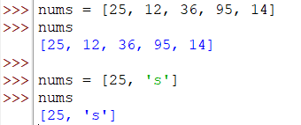

3. Data structures
List
A group of numbers, strings, characters, etc..
It’s similar to variable, but it can hold multiple values not only one value.
It can hold values of different types (numbers and strings for example).
List is as the string in terms of indexing
25 | 12 | 36 | 95 | 14
0 | 1 | 2 | 3 | 4
-5 | -4 | -3 | -2 | -1

Slide 17
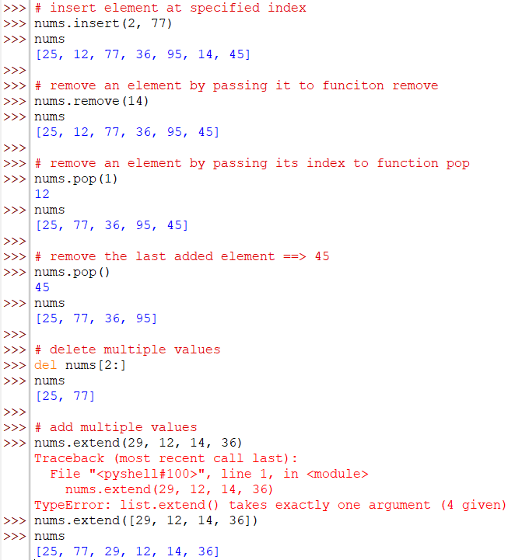


Lists together:
We can perform different operations on the list by using a built in functions:
[append(), clear(), copy(), count(), extend(), index(), insert(), pop(), remove(), reverse()]
Lists is a mutable, which means that we can change its values (add/remove/change)

Slide 18
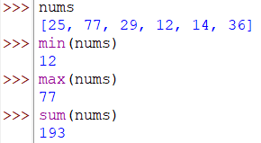
We can use python built in functions with lists, such as: min(), max()

Slide 19
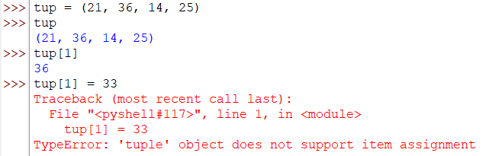
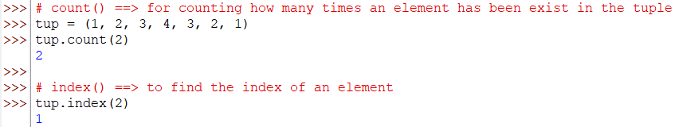
2. Tuple & Set
Tuple is almost same as lists, but it is immutable.
There are many methods in tuple [count(), index()]:

Slide 20
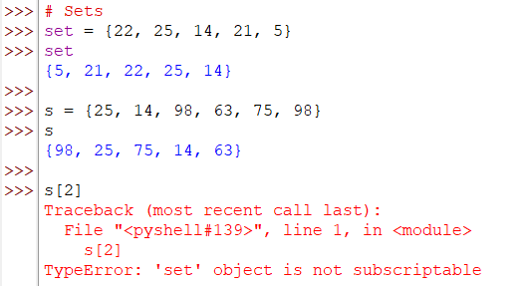
When should we use tuples?
If the project require not to change the grouped values. As the tuples are immutable, in iteration over the elements, tuples are faster than lists. So, tuples are used for enhancing the speed of our execution.
Sets are a collection of unique elements. It removes the repeated numbers automatically and returns the elements but not in the same sequence.
Sets use the concept of hach, and using hash improves the performance, and help us to fetch an element as fast as possible.
The indexing is not supported in sets, as they don’t have proper sequence.
There are many built in methods for sets
[such as pop(), remove(), union(), update(), etc..]

Slide 21

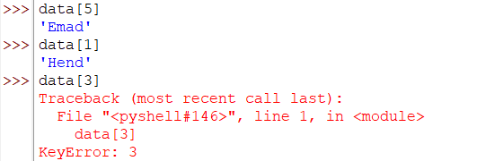
3. Dictionaries:
It is effective if we want to change the index (key) of the value.
We can specify the key of each value, the key should be immutable.
To fetch a particular value, We pass the key of the value into the square brackets of the dictionary.

Slide 22
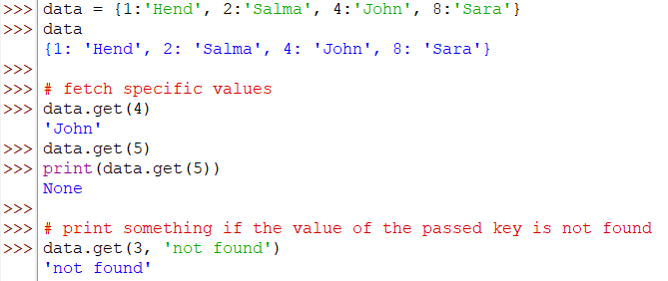
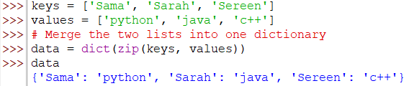
The dictionary has built in functions [ex. clear(), copy(), get(), items(), keys(), pop(), etc..]:
Create a dictionary with the help of lists:

Slide 23
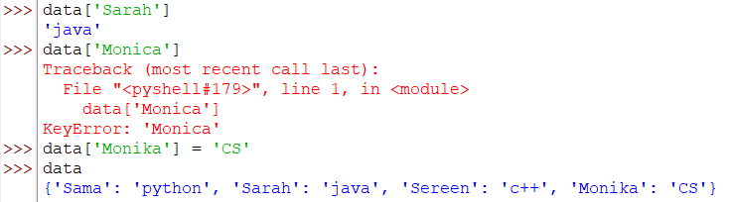

Add a new value and key:
Delete values:

Slide 24
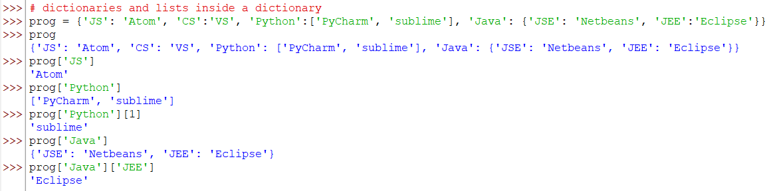
We can have a dictionary as a value in the dictionary itself, also we can have a list as a value in the dictionary itself:

Slide 25
Content
Operations
Variables
Data structures
Data types
Operators
Number systems conversion
Bitwise operations
Math library
User Input
Conditional statements
Loops
Examples
Arrays

Slide 26
4. Data types
None
Numeric
List
Tuple
Set
String
Range
Dictionary/ mapping
Sequence type

Slide 27
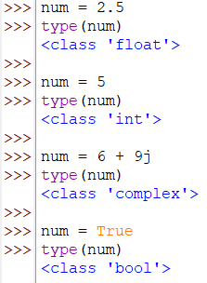
None:
When creating a variable which is not assigned to any value. In other languages, it is `null`, but in python is `None`.
Numeric:
Int
Float
Complex
bool

Slide 28
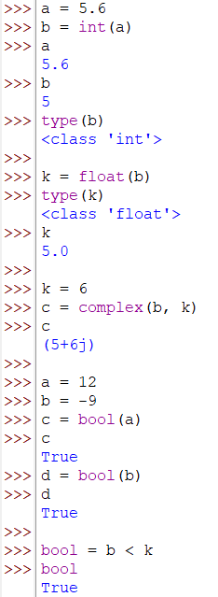
Converting from data type into another data type:

Slide 29
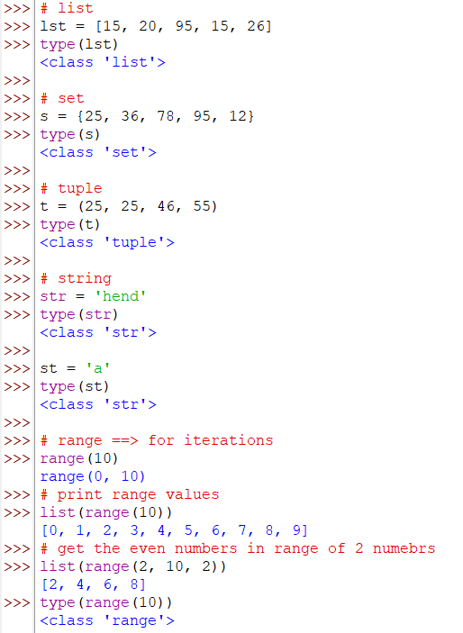
3. Sequence type:

Slide 30
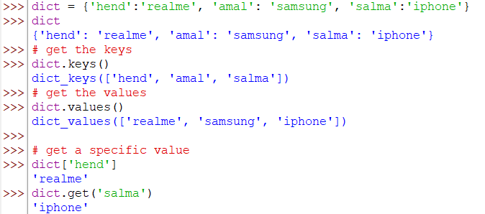
4. Mapping type (dictionary):
Note that the key should be unique in dictionaries.

Slide 31
Content
Operations
Variables
Data structures
Data types
Operators
Number systems conversion
Bitwise operations
Math library
User Input
Conditional statements
Loops
Examples
Arrays

Slide 32
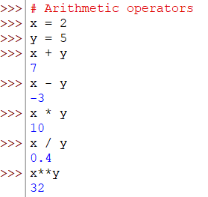
5. Operators
Arithmetic operators (sum/ subtract/ multiply/ division/ modulus)
Assignment operators
Relational operators
Logical operators
Unary operator

Slide 33
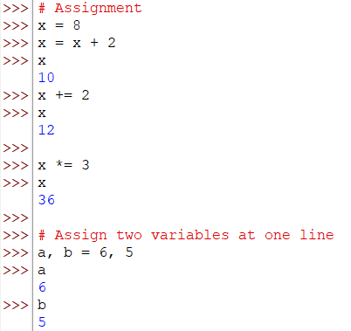
2. Assignment operators: (=)

Slide 34
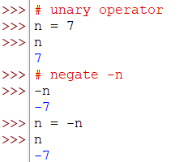
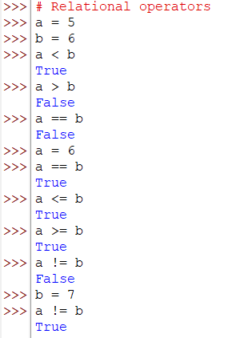
3. Unary operator:
4. Relational operators: Comparing two numbers.
(</ >/ ==/ <=/ >=/ !=)

Slide 35
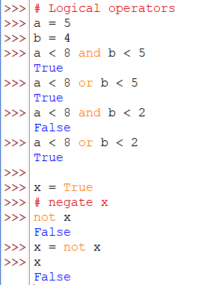
5. Logical operators:
(and, or, not)

Slide 36
Content
Operations
Variables
Data structures
Data types
Operators
Bitwise operations
Math library
User Input
Conditional statements
Loops
Examples
Arrays

Slide 37
6. Bitwise operators(with bits)
Complement (~ / tilde operator)
And (&)
Or (|)
XOR (^)
Left shift (<<)
Right shift (>>)
Complement (~):
~1 = 0
~0 = 1
So, it converts 1 to 0 and 0 to 1, but in bits (binary)
For example, we want to get the complement of 12:
Convert 12 to binary form:
12 = 00001100 ⇒ ~12 = 11110011 = -13
But, why 11110011 is equal to -13?
This is the concept of 2’s complement..

Slide 38
2’s complement:
In programming, we can store positive numbers only, so how can we store negative numbers?
We have to convert this negative numbers into positive ones at first, this is done with the help of 2’s complement.
2’s complement = 1’s complement + 1 ⇒ This is the formula.
so , we need to find the 1’s complement:
Find the binary format ⇒ +13 = 00001101
Find the complement of this binary number; convert 1 to 0 and 0 to 1 ⇒ 11110010
Add this binary number into 1 ⇒ 11110010 + 1 = 11110011
Thus, we get the 2’s complement which is 11110011
So, the complement of 12 ⇒ ~12 is equal to -13

Slide 39
Bitwise and (&):
12 & 13:
12 ⇒ 00001100 &
13 ⇒ 00001101
—-------------
00001100 ⇒ 12
Bitwise or(|):
12 | 13:
12 ⇒ 00001100 |
13 ⇒ 00001101
—--------------
00001101 ⇒ 13
XOR (^):
12 ^ 13:
12 ⇒ 00001100 ^
13 ⇒ 00001101
—----------------
00000001 ⇒ 1
Left shift (<<):
10 << 2:
10 ⇒ 00001010.000
1010 . 000
Then the zeros on the right side of the dot, will be shifted to the left by 2 as the example says:
So it will be:
00101000.0 ⇒ 40
So 10 << 2 = 40
Right shift (>>):
10 >> 2:
10 ⇒ 00001010.000
1010 . 000
Then two bits on the right side of the dot, will be shifted to the right by 2 as the example says:
So it will be:
00000010.1000 ⇒ 2
So 10 << 2 = 2
0 | 0 | 0
0 | 1 | 1
1 | 0 | 1
1 | 1 | 0

Slide 40
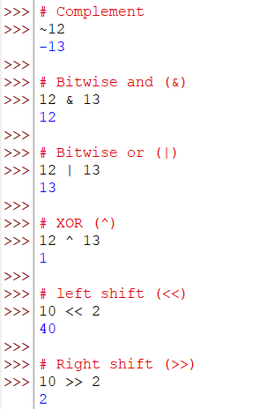

Slide 41
Content
Operations
Variables
Data structures
Data types
Operators
Bitwise operations
Math library
User Input
Conditional statements
Loops
Examples
Arrays

Slide 42
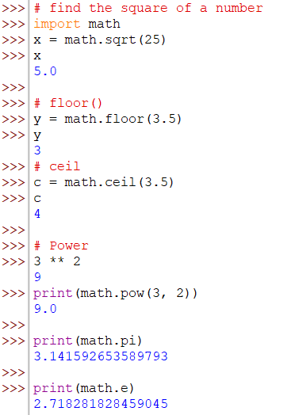
7. Math library
It has many math functions like sqrt() for finding the square root of a given number, many other useful mathematical built in functions.
It is better to use built in functions in software; as it is more readable for the developers.
It also contains constants like pi and epsilon.

Slide 43
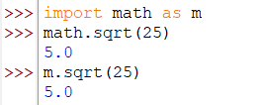

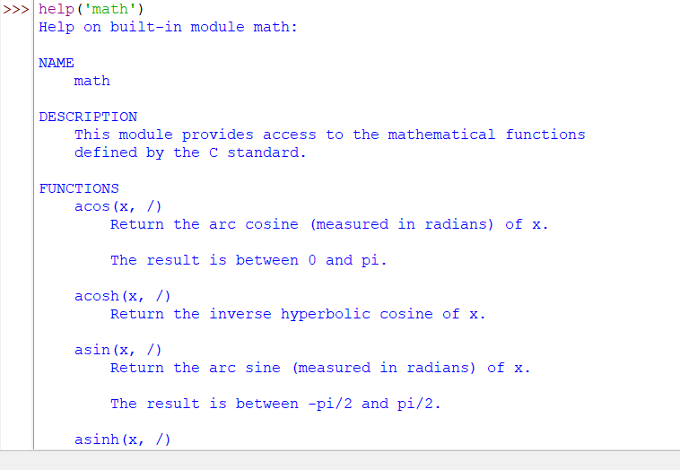
There are modules whose name is big, so we can use aliasing which means import the module with a shorter name like `import math as m`.
After importing the library, we import all the built in functions inside it. If we want to import only specific functions, we can say for example `from math import sqrt, pow`.
To know all the functions inside math module/ library:

Slide 44
Content
Operations
Variables
Data structures
Data types
Operators
Bitwise operations
Math library
User Input
Conditional statements
Loops
Examples
Arrays

Slide 45
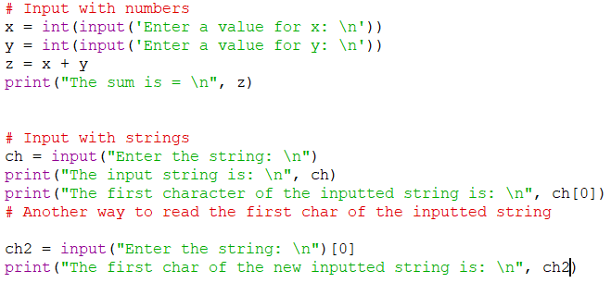
8. User input
We can take the values from the used using the function `input()`.
We can pass a sentence to the user by typing it inside the function.
This function always give us the string type, for example if we want the sum of 9 and 5, it will return 95 not 14 as it calculate the operation on strings not integers.
So, the solution for this problem is to cast the type into int/ float `int(input())`.

Slide 46

We can use the function `eval` if we want to evaluate the inputted expression into function `input`.
code

Slide 47
Content
Operations
Variables
Data structures
Data types
Operators
Bitwise operations
Math library
User Input
Conditional statements
Loops
Examples
Arrays

Slide 48
9. Conditional statements
If (A block, in python, it is called suite).
If…else
If….elif…else
Nested if

Slide 49
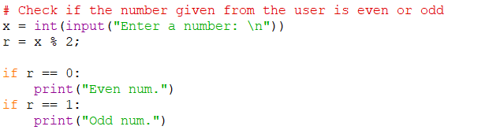
The mission in programming is not just writing the code and get the output, we have to care about the efficiency of the program performance.
In case of this code:
This code is not efficient; as if the first condition is true, it will be executed. In addition, the second one will be executed even if it is false. So there is no need to execute the second statement in this case. To do that: we use if..else.
Code

Slide 50
Content
Operations
Variables
Data structures
Data types
Operators
Bitwise operations
Math library
User Input
Conditional statements
Loops
Examples
Arrays

Slide 51
10. Loops
While loop, for loop, and for..else loop
Continue, break, and pass statements
List Comprehension
Examples

Slide 52
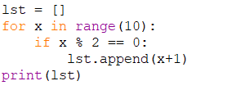


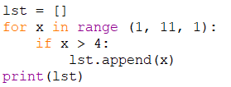

List Comprehension:
[Output Collection Condition]
Ex: [x+1 for x in range(5) if x % 2 == 2]
List comprehension with for loop:
List comprehension with single if condition:
≡
≡
≡

Slide 53
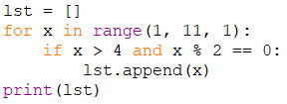
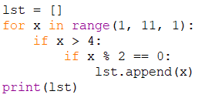
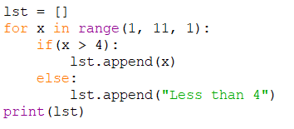
List comprehension with nested if condition:
List comprehension with single if..else conditions:
≡
≡
≡

Slide 54
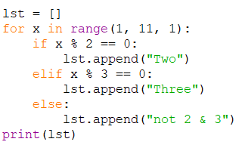
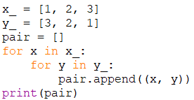

List comprehension with if..elif..if:
List comprehensions with nested if:
≡
≡

Slide 55
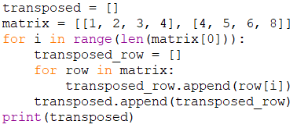
Transpose of matrix:
Note that: List comprehension is faster than normal loops in terms of performance, very simple and readable, but if it is used for more than one simple condition, it will not be able to handle it without sacrificing readability. This is the major issue with list comprehension.
≡

Slide 56
Content
Operations
Variables
Data structures
Data types
Operators
Bitwise operations
Math library
User Input
Conditional statements
Loops
Arrays

Slide 57
11. Arrays
Intro.
Array values from User
Why numpy?
Ways of Creating Arrays in Numpy
Copying an array
Working with matrix

Slide 58
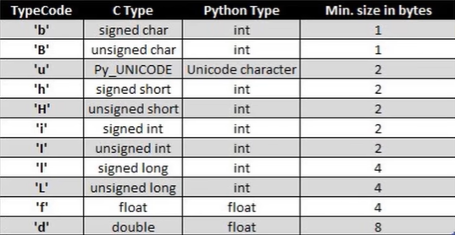

Intro:
Contains the values of the same type
In python, it doesn’t have a fixed size
We have to import the library `array` to work with arrays.
To create an array, we have to pass two parameters:
Type code → for specifying the type of the array, if changing it, the array size will be changed as well. (byte / int/ long)
Signed vs. unsigned:
Signed → from a negative to a positive range.
Unsigned → positive range only

Slide 59

There are many functions can be used with arrays as:
`buffer_info()` ⇒ Give you the size of the elements added.
This function returns a tuple of 2 numbers (the address, the array size/no.of elements)
`type_code` ⇒ print the type of the code you are adding elements with
`append()` ⇒ add new values to the array
`reverse()` ⇒ Reverse the elements of the array

Slide 60

Why numpy?
There are two types of arrays:
One dimensional array → which have one row and multiple columns.
Multi-dimensional array → Multiple rows and multiple columns.
Array package in python doesn’t support multi-dimensional arrays, so we use a third-party package which is “numpy”
NumPy documentation

Slide 61

Ways of Creating Arrays in Numpy
array()
linspace()
logspace()
arange()
zeros()
ones()
array():
There is no need to specify the array type (optional).

Slide 62

2. linspace():
It divides the range of start to stop into n parts.
It takes two parameters: start, stop, and n(no.of division parts).
The stop value is included.
All the values returned are float.
In case of not specifying the no of parts, it will divide the numbers into stop parts.

Slide 63


3. logspace():
It divides the range of 10**start to 10**stop into n parts.
4. arange():
It takes 3 parameters: start, stop, and step

Slide 64


5. zeros(): Create an array of zeros
6. ones(): Create an array of ones

Slide 65
Content
Operations
Variables
Data structures
Data types
Operators
Bitwise operations
Math library
User Input
Conditional statements
Loops
Arrays

